Slide 1
Nearest Neighbors

Slide 2
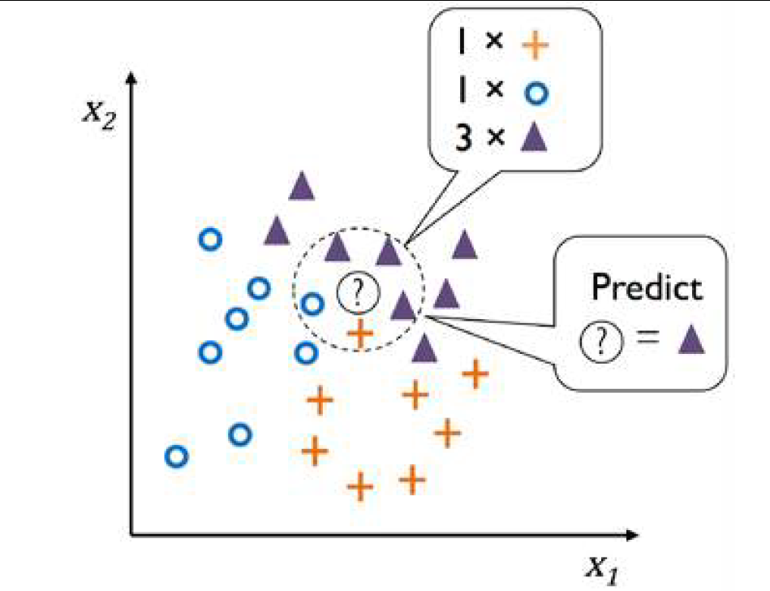
K Nearest Neighbors (KNN)
KNN is a typical example of a lazy learner. It is called "lazy" because it doesn't learn a discriminative function from the training data but memorizes the training dataset instead
It is nonparametric model as it can't be characterized by a fixed set of parameters unlike linear regression, logistic regression, linear SVM. Decision Trees are also non parametric
KNN belongs to a subcategory of nonparametric models that is described as instance-based learning. It just memorizes training data and has no cost of learning.

Slide 3
K Nearest Neighbors (KNN)
Steps
Choose the number of k and a distance metric.
Find the k-nearest neighbors of the data record that we want to classify.
Assign the class label by majority vote.
The right choice of k is crucial to finding a good balance between overfitting and underfitting.
Distance metrics – depends on the problem. You may use Euclidean distance, Manhattan distance, cosine similarity etc.
Majority voting can be weighted uniformly or based on the distance. Neighbors who are closer have a higher say than those far away.
Regression can also be done where instead of voting, we take an average / weighted average.

Slide 4
K Nearest Neighbors (KNN)
Pros
It is very simple algorithm to understand and interpret.
It is very useful for nonlinear data because there is no assumption about data in this algorithm.
It is a versatile algorithm as we can use it for classification as well as regression.
It has relatively high accuracy but there are much better supervised learning models than KNN.
Cons
It is computationally a bit expensive algorithm because it stores all the training data.
High memory storage required as compared to other supervised learning algorithms.
Prediction is slow in case of big N.
It is very sensitive to the scale of data as well as irrelevant features.

